Slide 1
Architecture of Enterprise Applications 1 Overview of Enterprise Applications
Haopeng Chen
REliable, INtelligent and Scalable Systems Group (REINS)
Shanghai Jiao Tong University
Shanghai, China
http://reins.se.sjtu.edu.cn/~chenhp
e-mail: chen-hp@sjtu.edu.cn

Slide 2
Contents and Objectives
Contents
Architecture
Scope
Objectives
能够根据应用系统的规模，确定适合的技术路线，从单机部署到分布式集群部署，再到微服务架构和云部署
能够根据系统需求，设计并实现由合理的有状态服务与无状态服务构成服务层

Slide 3
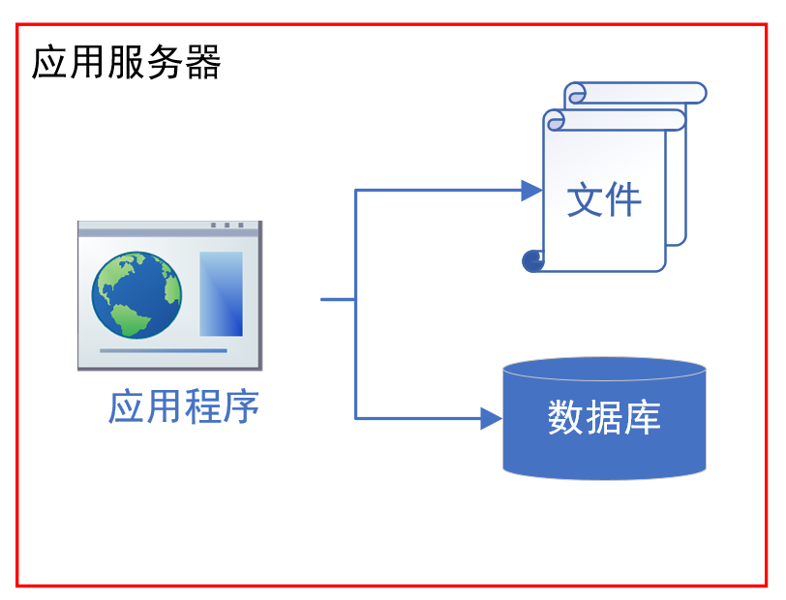
Architecture of Java Web Application

Slide 4
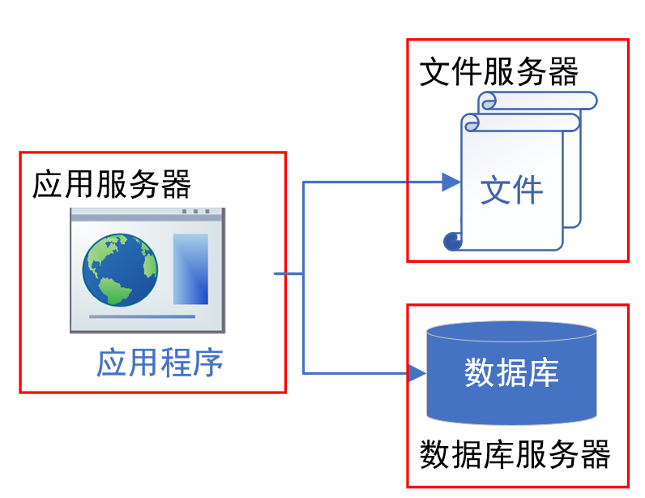
Architecture of Java Web Application

Slide 5
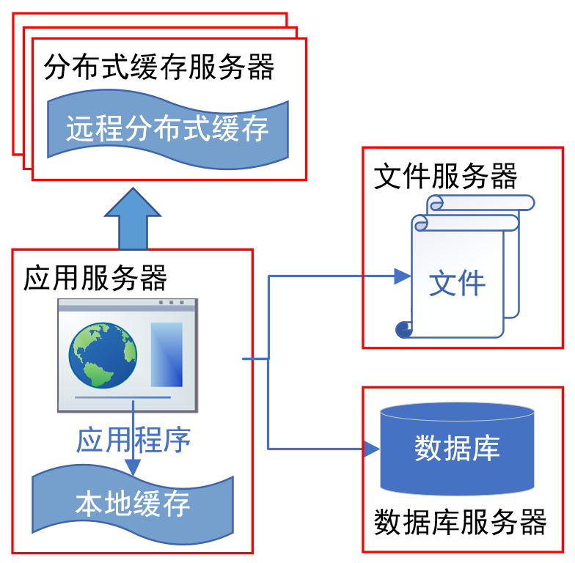
Architecture of Java Web Application

Slide 6
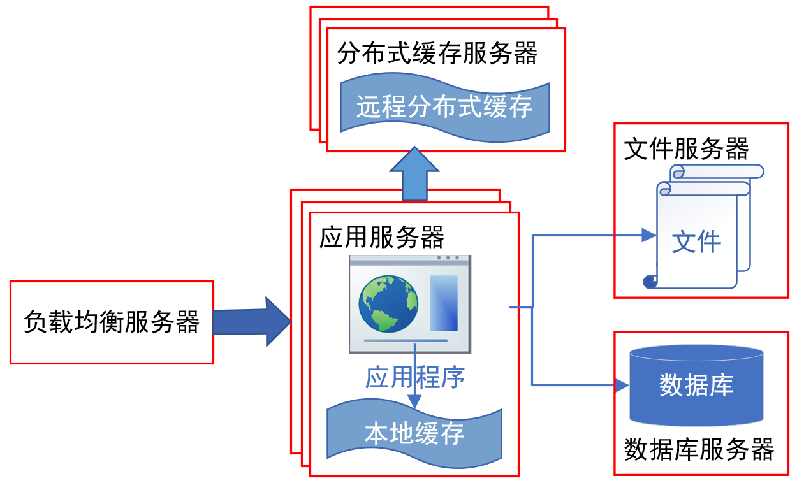
Architecture of Java Web Application

Slide 7
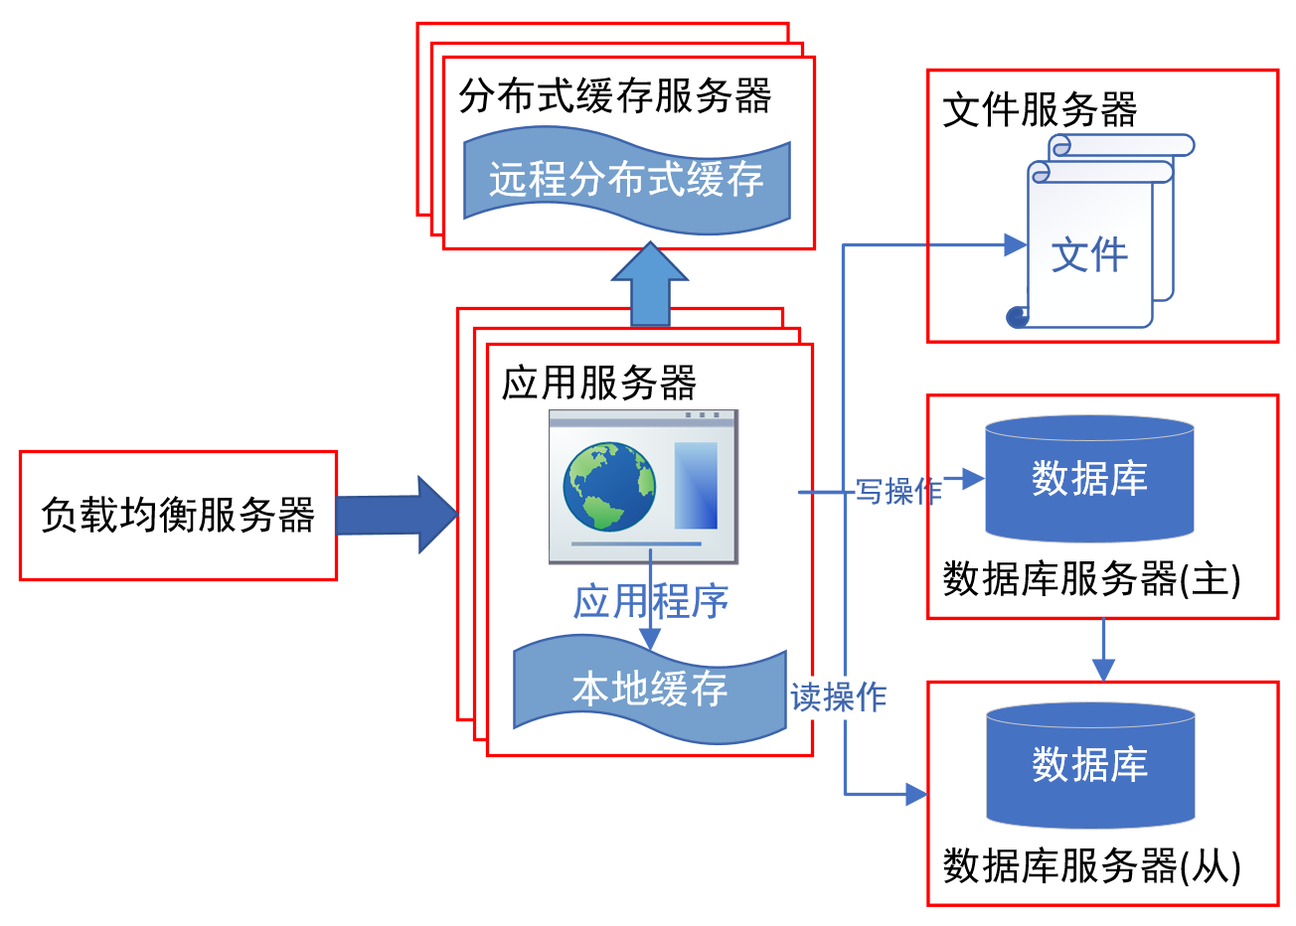
Architecture of Java Web Application

Slide 8
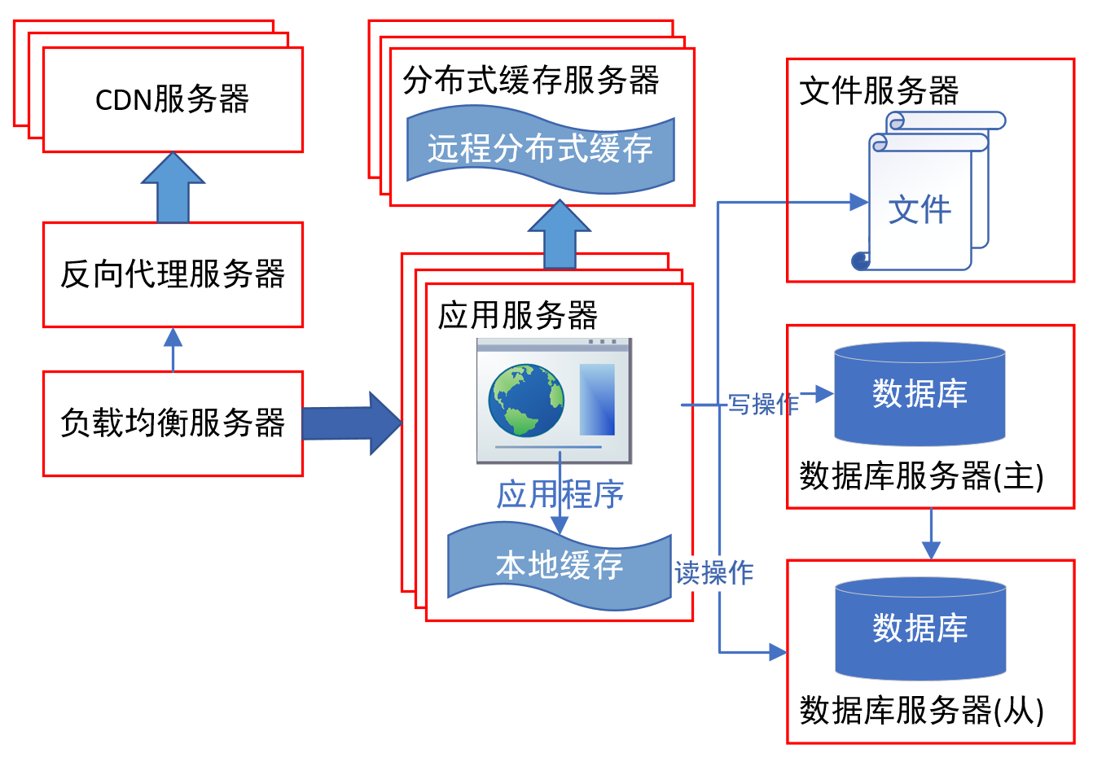
Architecture of Java Web Application

Slide 9
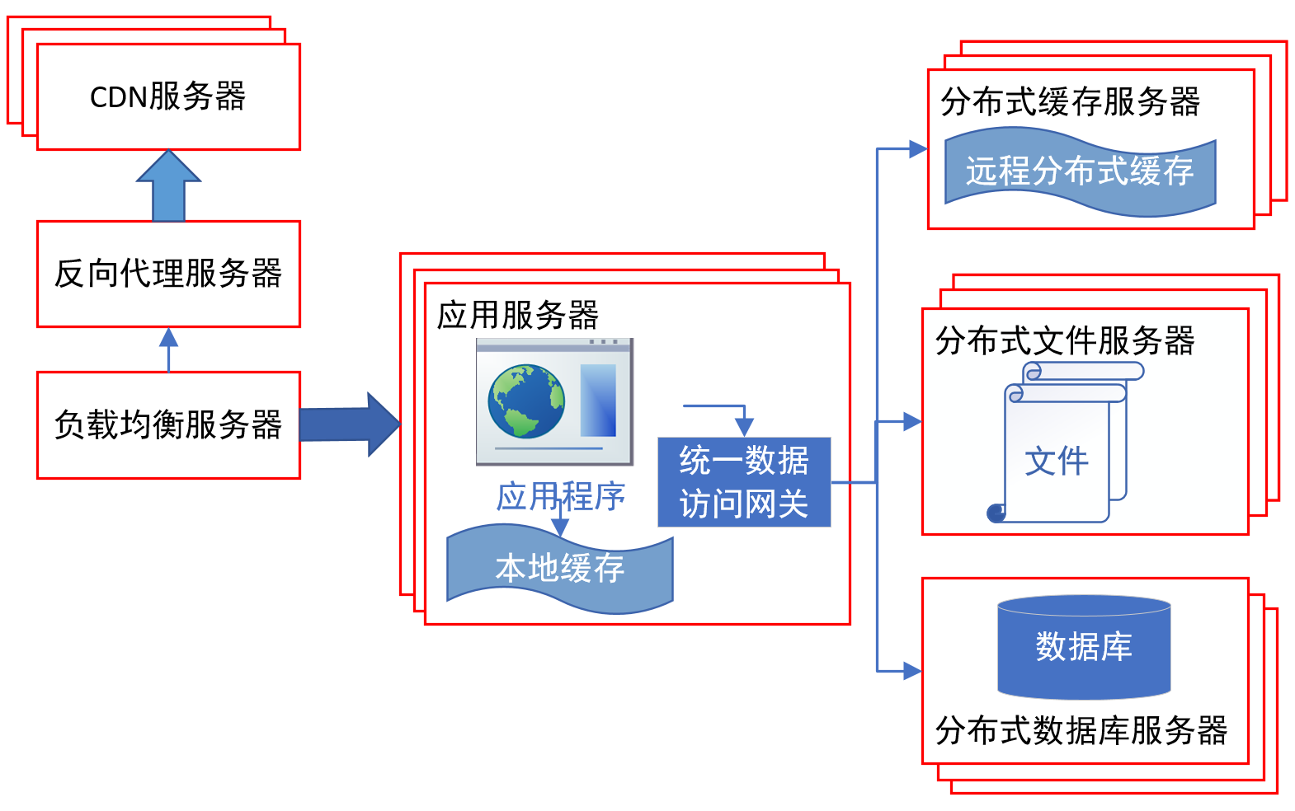
Architecture of Java Web Application

Slide 10
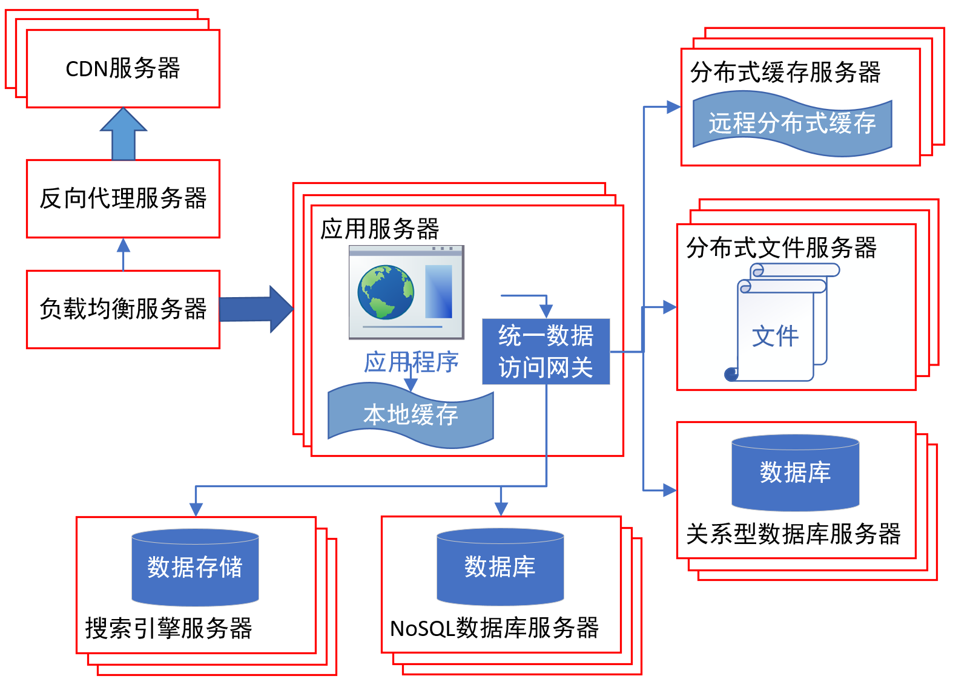
Architecture of Java Web Application

Slide 11
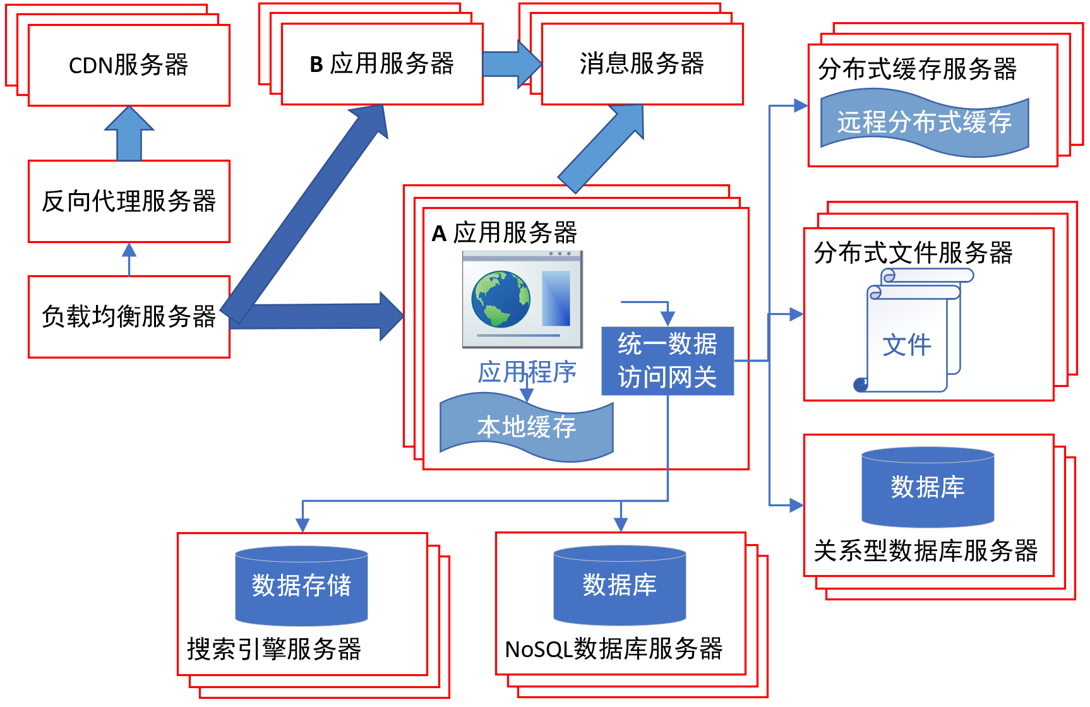
Architecture of Java Web Application

Slide 12
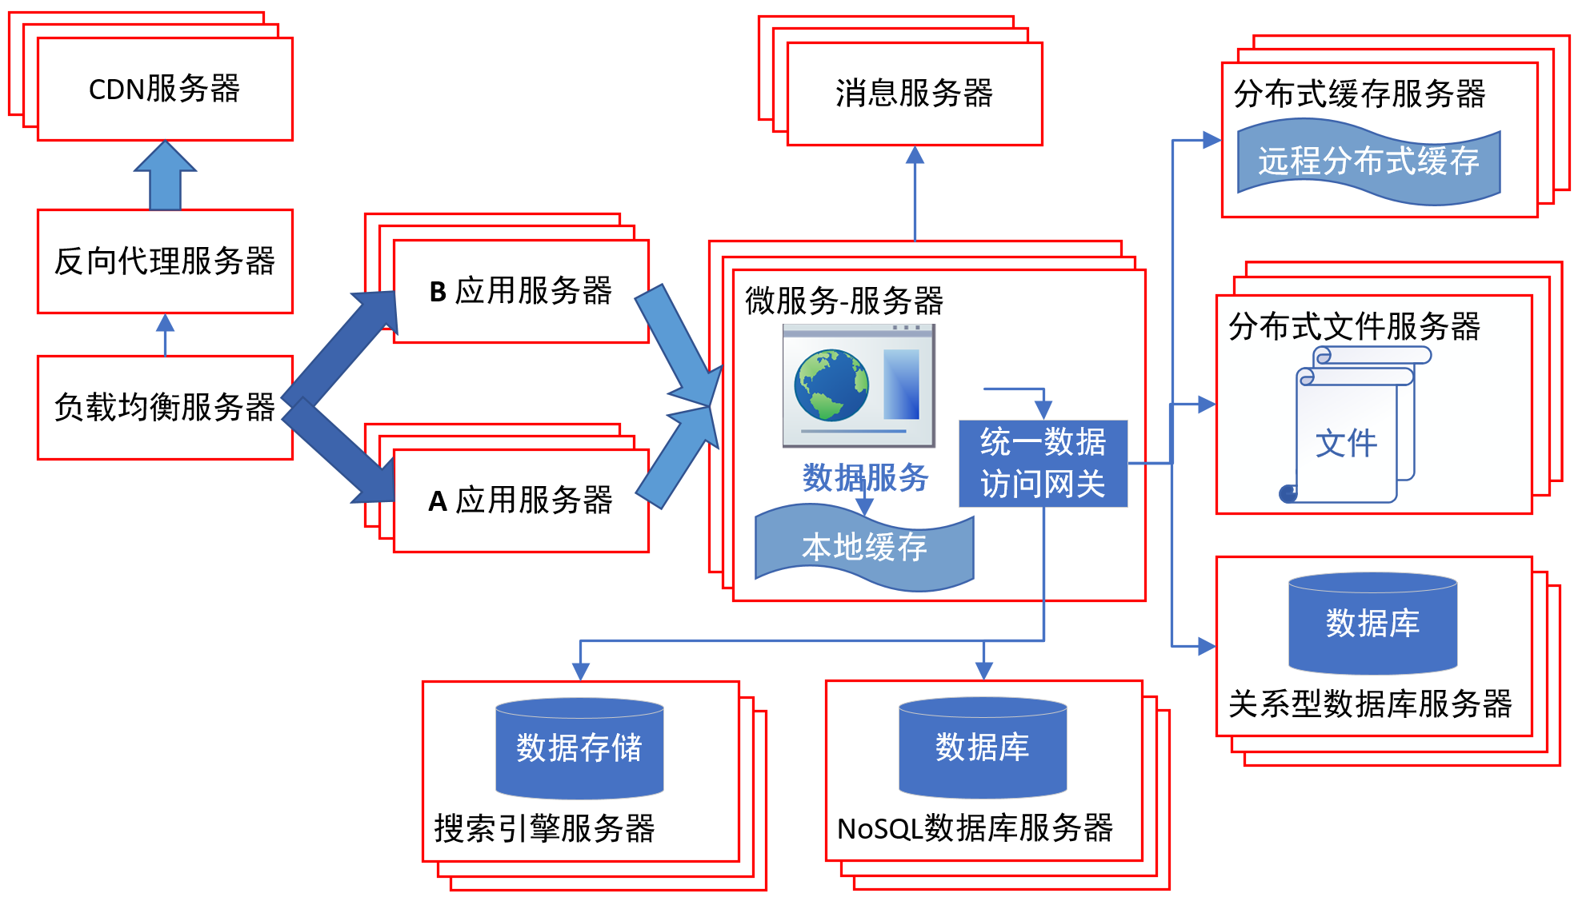
Architecture of Java Web Application

Slide 13
Architecture of Enterprise Applications 1 Stateful and Stateless Services
Haopeng Chen
REliable, INtelligent and Scalable Systems Group (REINS)
Shanghai Jiao Tong University
Shanghai, China
http://reins.se.sjtu.edu.cn/~chenhp
e-mail: chen-hp@sjtu.edu.cn

Slide 14
Recall: HTTP session state
HTTP is a stateless protocol
A stateless protocol does not require the HTTP server to retain information or status about each user for the duration of multiple requests.
from: https://www.openhome.cc/Gossip/ServletJSP/BehindHttpSession.html

Slide 15
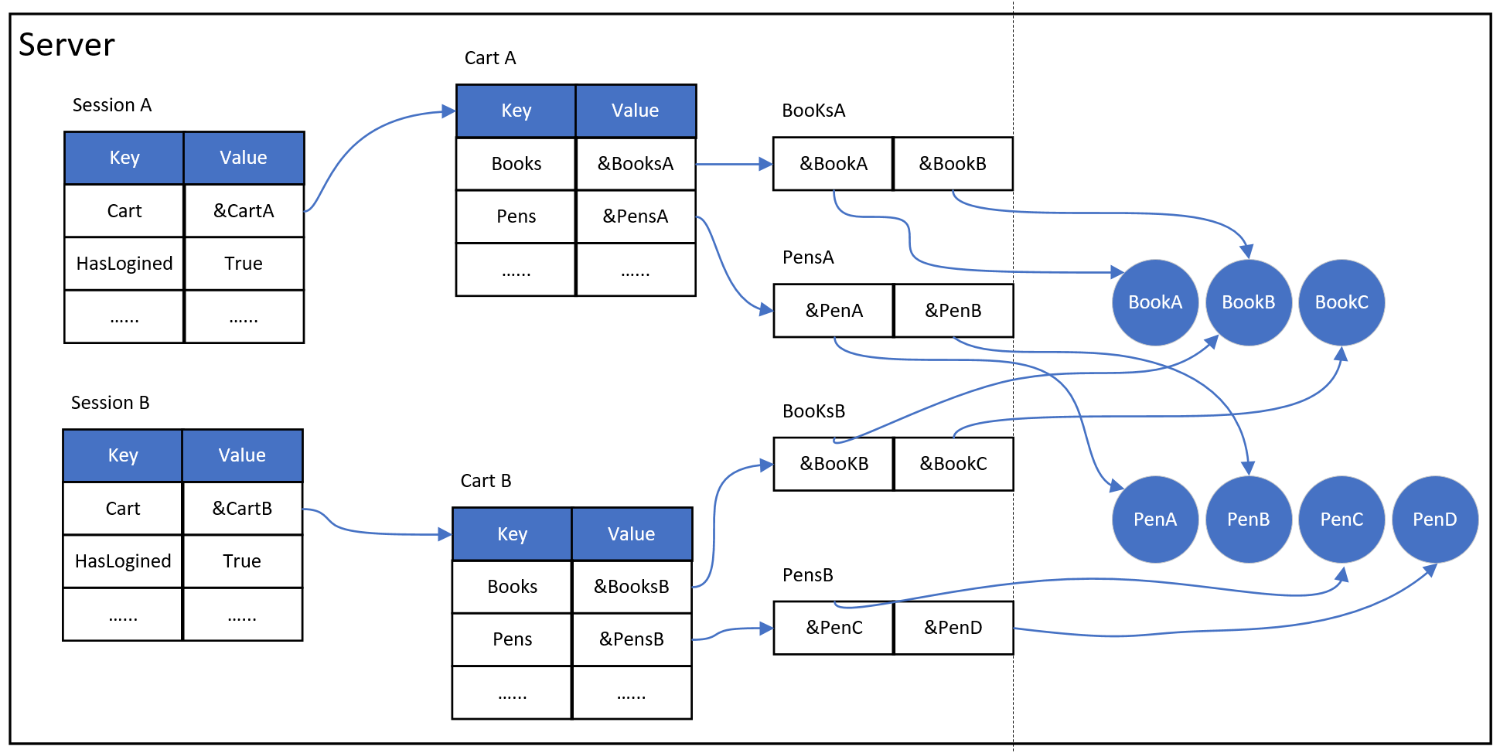
Recall: HTTP session state
HTTP is a stateless protocol

Slide 17
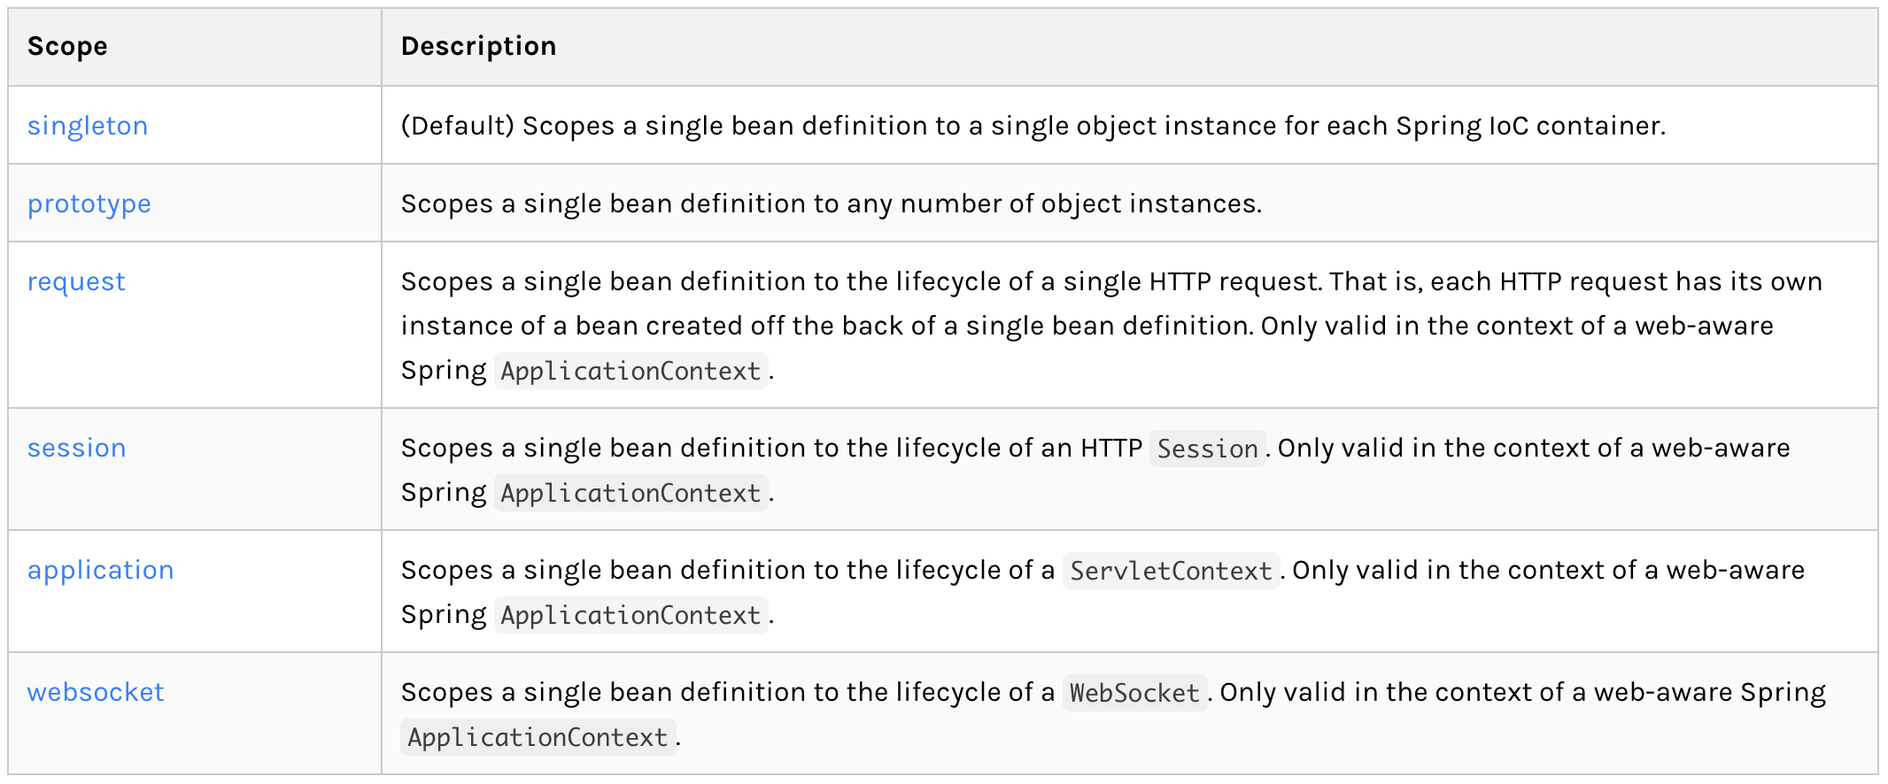
Spring Bean Scopes
What’s the meaning of scope?

Slide 18
Scope
Singleton : Stateless

Slide 19
Scope
Prototype : Stateful

Slide 20
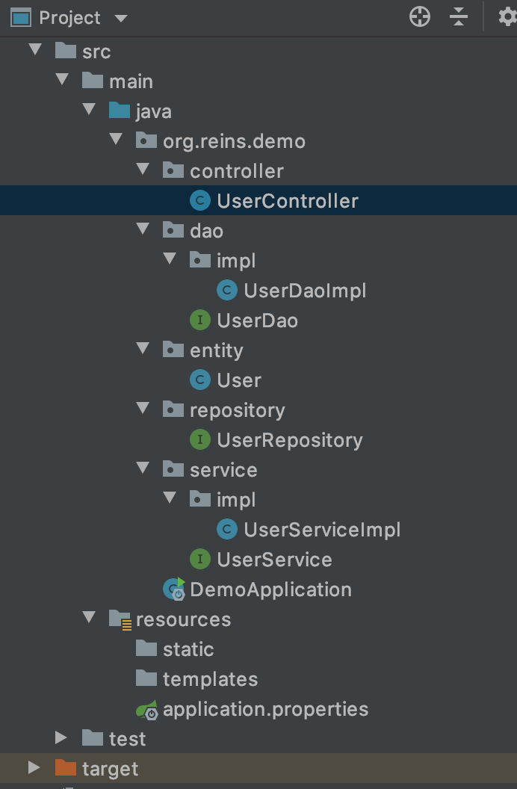
Default Scope - singleton
UserController.java
@RestController public class UserController { @Autowired private UserService userService; @GetMapping(value = "/findUser/{id}") public User findOne(@PathVariable("id") String id) { System.out.println(userService); return userService.findUserById(Integer.valueOf(id)); }; }
UserServiceImpl.java
@Service public class UserServiceImpl implements UserService { @Autowired private UserDao userDao; @Override public User findUserById(Integer id) { return userDao.findOne(id); } }

Slide 21
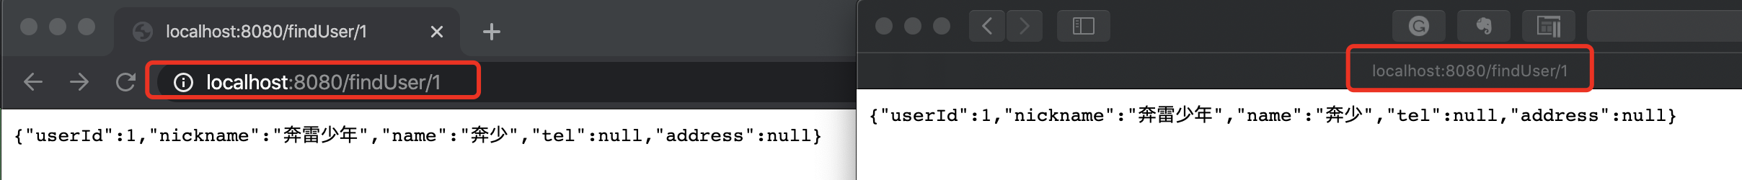
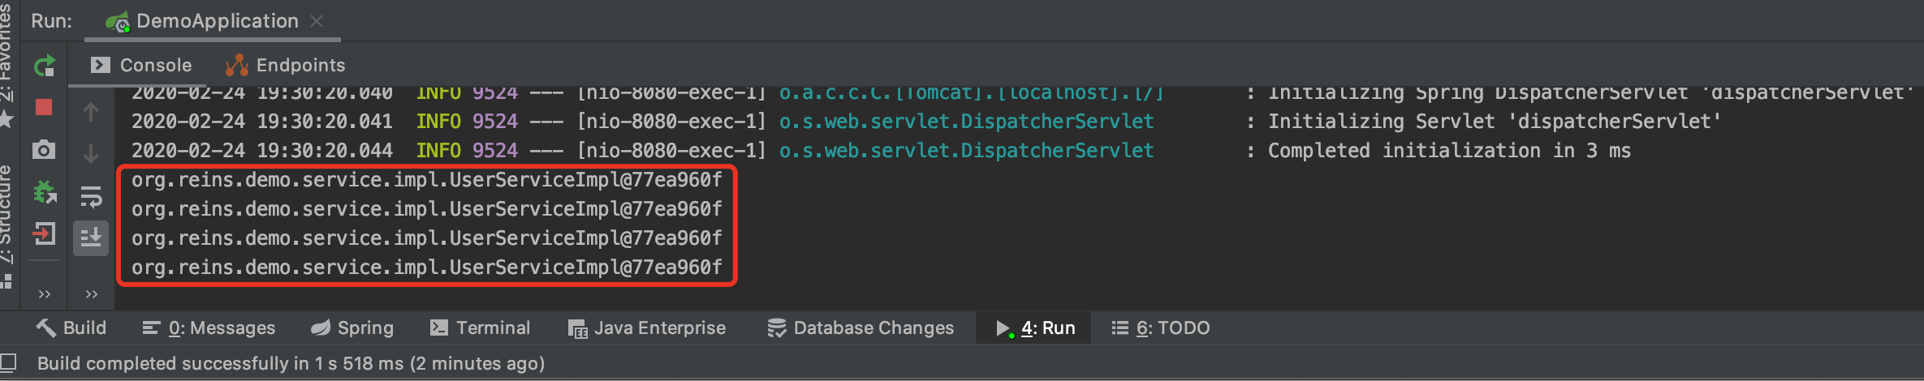
Default Scope - singleton
Single Service instance

Slide 22
Scope - prototype
UserController.java
@RestController public class UserController { @Autowired private UserService userService; @GetMapping(value = "/findUser/{id}") public User findOne(@PathVariable("id") String id) { System.out.println(userService); return userService.findUserById(Integer.valueOf(id)); }; }
UserServiceImpl.java
@Service @Scope("prototype") public class UserServiceImpl implements UserService { @Autowired private UserDao userDao; @Override public User findUserById(Integer id) { return userDao.findOne(id); } }
prototype

Slide 23
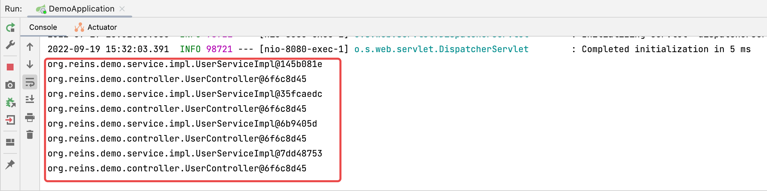
Scope - prototype
Now, different

Slide 24
Scope - prototype
UserController.java
@RestController
@Scope("prototype") public class UserController { @Autowired private UserService userService; @GetMapping(value = "/findUser/{id}") public User findOne(@PathVariable("id") String id) { System.out.println(userService); return userService.findUserById(Integer.valueOf(id)); }; }
prototype
UserServiceImpl.java
@Service @Scope("prototype") public class UserServiceImpl implements UserService { @Autowired private UserDao userDao; @Override public User findUserById(Integer id) { return userDao.findOne(id); } }
prototype

Slide 25
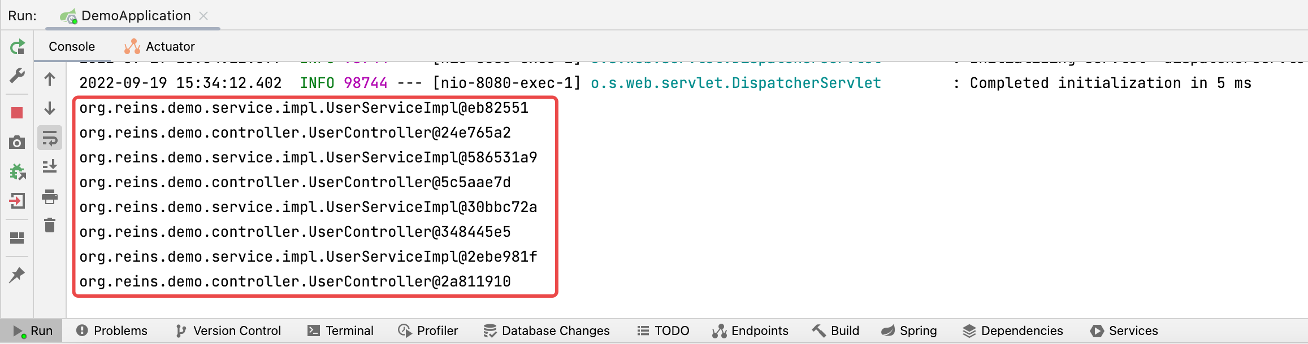
Scope - prototype
Now different. But not good!

Slide 26
Scope - prototype
UserController.java
@RestController public class UserController { @Autowired WebApplicationContext applicationContext; @GetMapping(value = "/findUser/{id}") public User findOne(@PathVariable("id") String id) { UserService userService = applicationContext.getBean(UserService.class); System.out.println(userService); return userService.findUserById(Integer.valueOf(id)); }; }
WebApplicationContext
UserService
UserServiceImpl.java
@Service @Scope("prototype") public class UserServiceImpl implements UserService { @Autowired private UserDao userDao; @Override public User findUserById(Integer id) { return userDao.findOne(id); } }
prototype

Slide 27
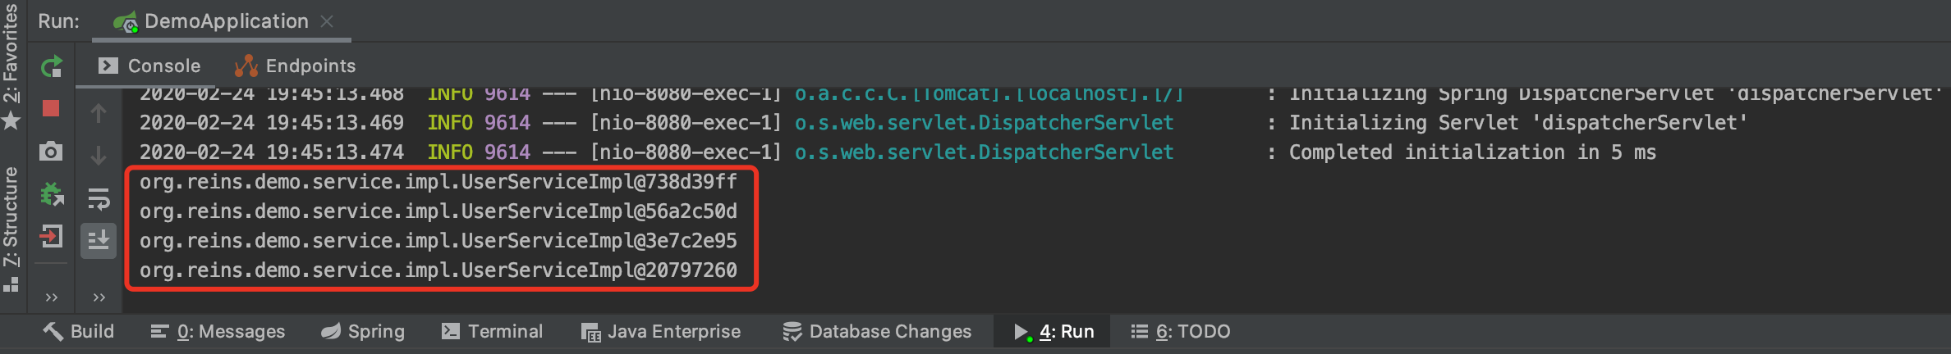
Scope - prototype
Now different. Why is this solution better?

Slide 28
Scope - session
UserController.java
@RestController public class UserController { @Autowired WebApplicationContext applicationContext; @GetMapping(value = "/findUser/{id}") public User findOne(@PathVariable("id") String id) { UserService userService = applicationContext.getBean(UserService.class); System.out.println(userService); return userService.findUserById(Integer.valueOf(id)); }; }
WebApplicationContext
UserService
UserServiceImpl.java
@Service @Scope(”session") public class UserServiceImpl implements UserService { @Autowired private UserDao userDao; @Override public User findUserById(Integer id) { return userDao.findOne(id); } }
session

Slide 29
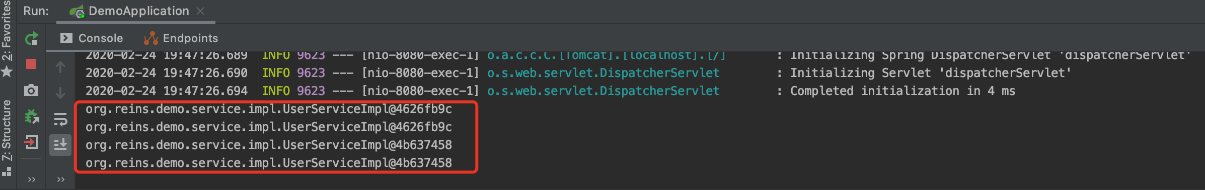
Scope - session
Two Service instances

Slide 30
Scope - session
UserController.java
@RestController
@Scope(”session") public class UserController { @Autowired WebApplicationContext applicationContext; @GetMapping(value = "/findUser/{id}") public User findOne(@PathVariable("id") String id) { UserService userService = applicationContext.getBean(UserService.class); System.out.println(userService);
System.out.println(this); return userService.findUserById(Integer.valueOf(id)); }; }
session
WebApplicationContext
UserService
this
UserServiceImpl.java
@Service @Scope(”prototype") public class UserServiceImpl implements UserService { @Autowired private UserDao userDao; @Override public User findUserById(Integer id) { return userDao.findOne(id); } }
prototype

Slide 31
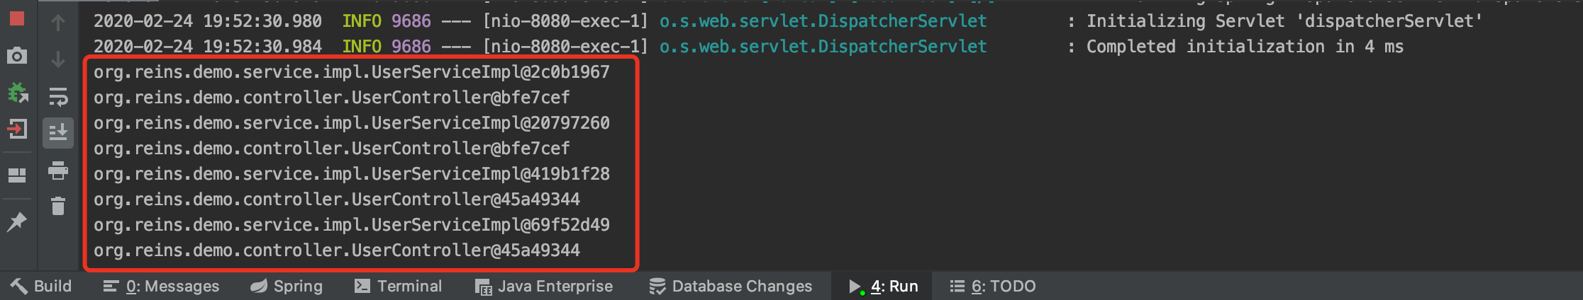
Scope - session
Two Controller instances
Four Service instances

Slide 32
Scope - session
UserController.java
@RestController
@Scope(”session") public class UserController { @Autowired WebApplicationContext applicationContext; @GetMapping(value = "/findUser/{id}") public User findOne(@PathVariable("id") String id) { UserService userService = applicationContext.getBean(UserService.class); System.out.println(userService);
System.out.println(this); return userService.findUserById(Integer.valueOf(id)); }; }
session
WebApplicationContext
UserService
this
UserServiceImpl.java
@Service @Scope(”session") public class UserServiceImpl implements UserService { @Autowired private UserDao userDao; @Override public User findUserById(Integer id) { return userDao.findOne(id); } }
session

Slide 33
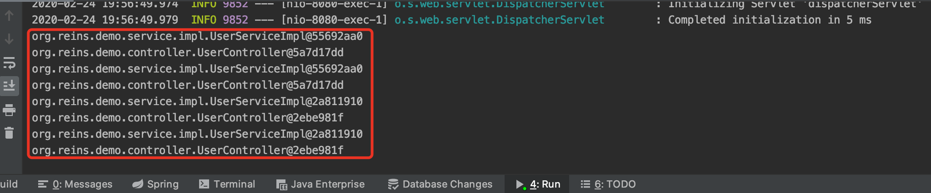
Scope - session
Two Controller instances
Two Service instances

Slide 34
Scope - session
UserController.java
@RestController
@Scope(”prototype") public class UserController { @Autowired WebApplicationContext applicationContext; @GetMapping(value = "/findUser/{id}") public User findOne(@PathVariable("id") String id) { UserService userService = applicationContext.getBean(UserService.class); System.out.println(userService);
System.out.println(this); return userService.findUserById(Integer.valueOf(id)); }; }
prototype
WebApplicationContext
UserService
this
UserServiceImpl.java
@Service @Scope(”session") public class UserServiceImpl implements UserService { @Autowired private UserDao userDao; @Override public User findUserById(Integer id) { return userDao.findOne(id); } }
session

Slide 35
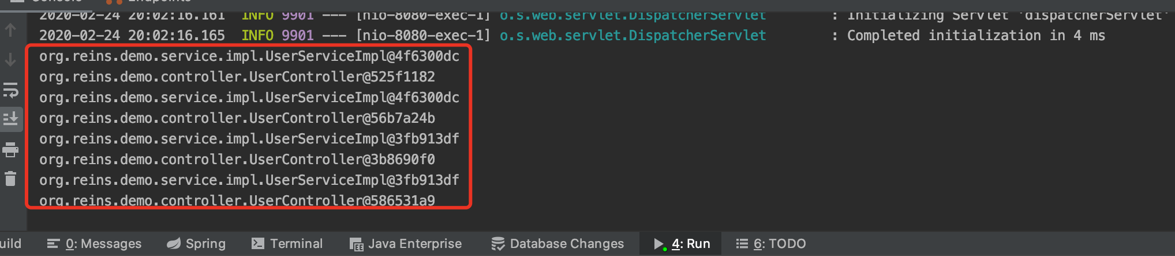
Scope - session
Four Controller instances
Two Service instances

Slide 36
Summary
2 Browsers(2 Sessions), 4 Requests( 2 times / session)
How should we design the scopes of Beans?
 |  | Controller
 |  | Prototype | session
Service | prototype | 4 service instances 4 controller instances | 4 service instances 2 controller instances
 | session | 2 service instances 4 controller instances | 2 service instances 2 controller instances

Slide 37
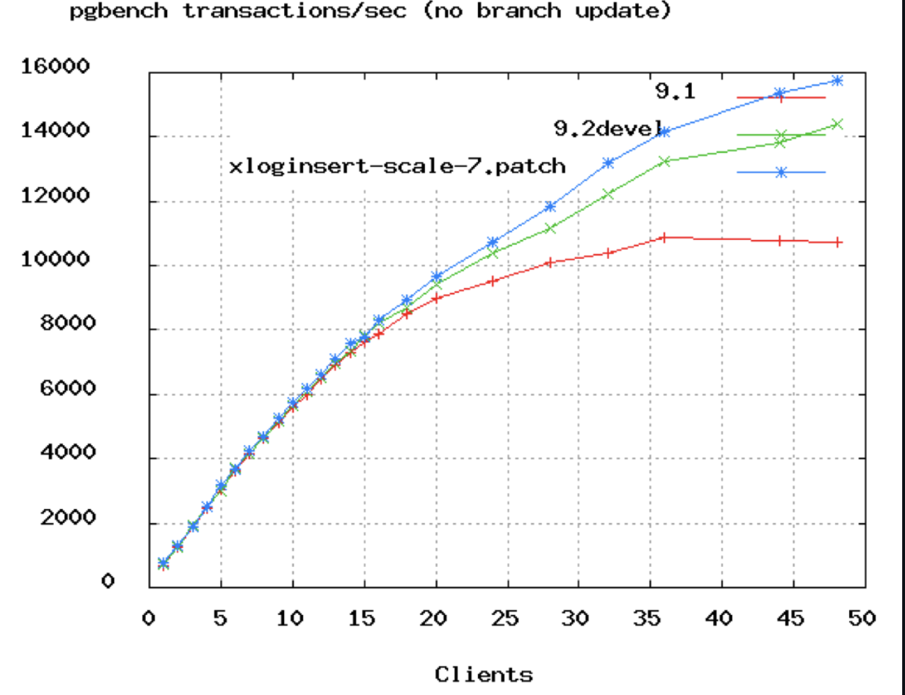
Database Connection Pool Size
https://github.com/brettwooldridge/HikariCP/wiki/About-Pool-Sizing
https://www.youtube.com/watch?v=_C77sBcAtSQ
connections =
((core_count * 2) + effective_spindle_count)
Axiom: You want a small pool, saturated with threads waiting for connections.

Slide 38
References
Web开发的发展史
https://linux.cn/article-3166-1.html
The IoC Container- Bean Scopes
https://docs.spring.io/spring/docs/5.2.3.RELEASE/spring-framework-reference/core.html#beans-factory-scopes
Quick Guide to Spring Bean Scopes
https://www.baeldung.com/spring-bean-scopes
Spring注解中@Scope 的使用解说
https://blog.csdn.net/cuichunchi/article/details/79170240

Slide 39

Thank You!

